Slide 1
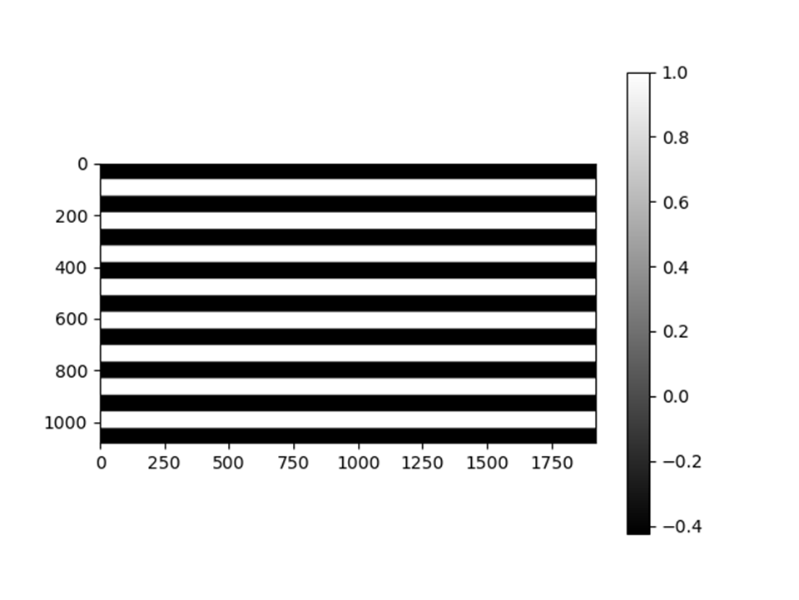
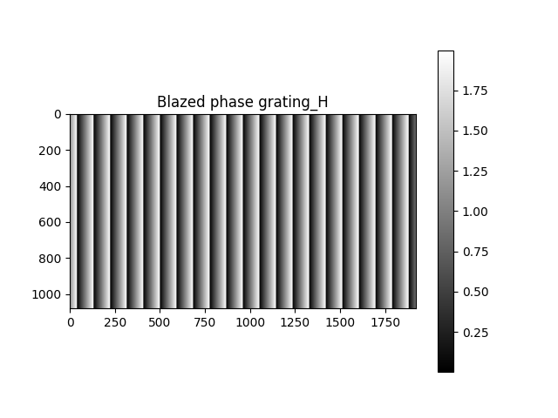
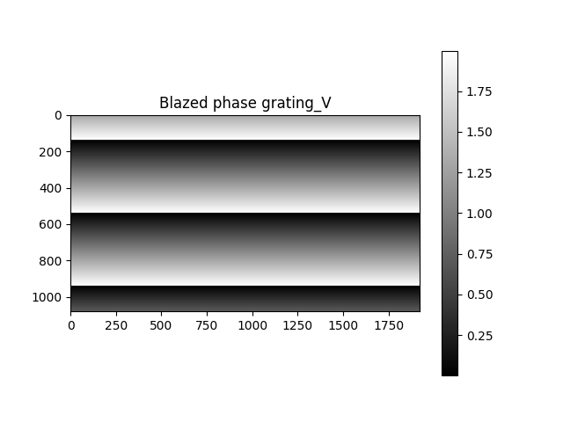
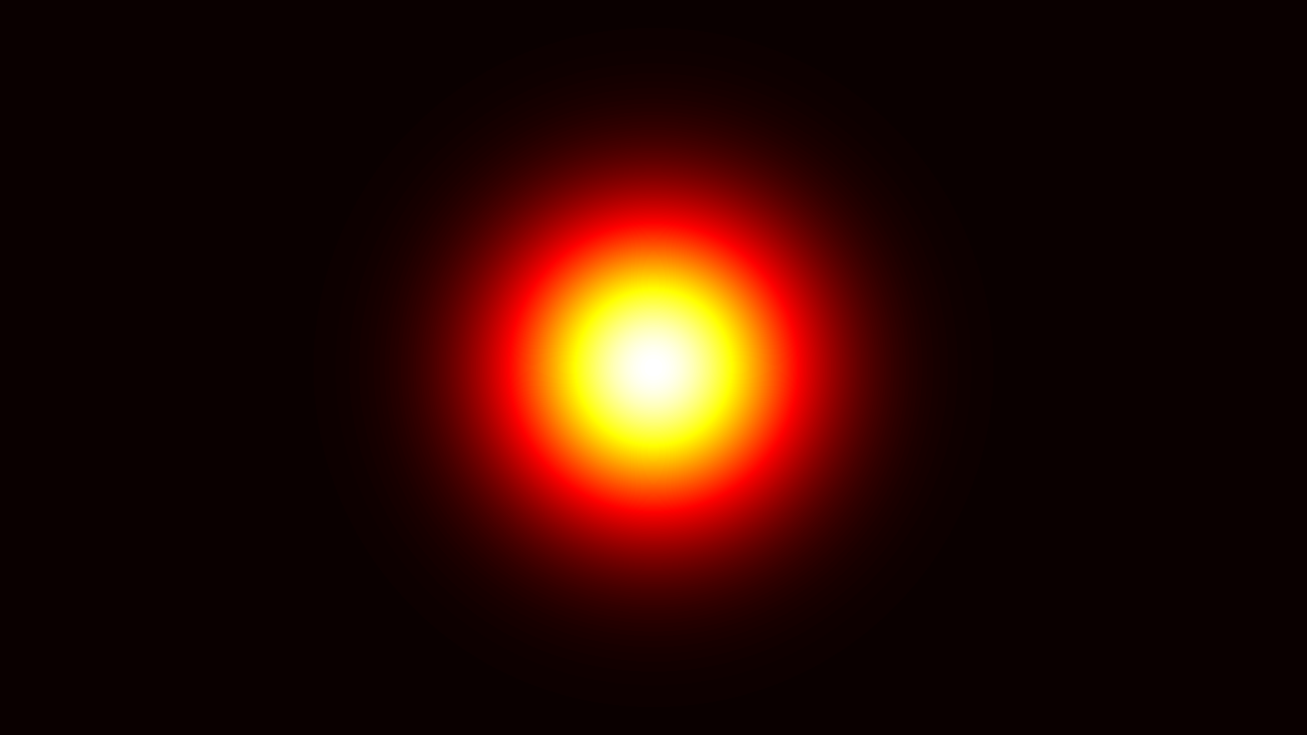
Simulation FFT of binary phase grating with/ without blazed phase gratings. 1 One channel
Size 1920*1080
Binary phase grating
Phase1=exp(i*0)
Phase2=exp(i*0.64*π)
Blazed phase grating (horizontal)
Phase=exp(i*(0-2 π))
Blazed phase grating (vertical)
Phase=exp(i*(0-2 π))
In the simulation
FFT of binary phase grating is calculated.
FFT of Blazed phase grating (horizontal) × Blazed phase grating (vertical).
FFT of binary phase grating × blazed phase grating (horizontal) × blazed phase grating (vertical).
FFT of Gaussian beam × binary phase grating × blazed phase grating (horizontal) × blazed phase grating (vertical) to observe diffraction pattern clearly.
Gaussian Beam
Size 1920*1080
Beam width= 150px
Notes:
Add experiment figs.
Add combined blazeds with matix. With conversion.

Slide 2

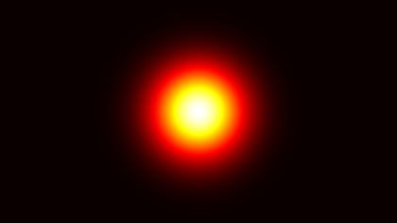
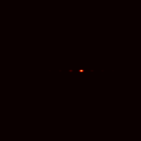




2. Simulation results of blazed phase gratings
$p=$ $128px$
FFT of Gaussian Beam × blazed phase grating
In calculation full size is used, for showing it the size is 200*200.
×
1.5π
1.85π
2π
2.5π
I_0= 0.005 I_1= 0.985
I_0=0.1*E-16
I_1= 0.999
I_0= 0.034 I_1= 0.797
I_2=0.098
I_0= 0.085
I_1= 0.818

Slide 3

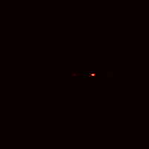
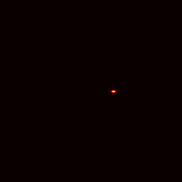
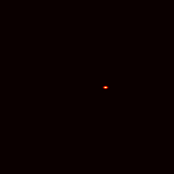
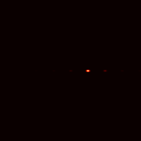

2. Simulation results of blazed phase gratings
$p=$ $79px$
FFT of Gaussian Beam × blazed phase grating
In calculation full size is used, for showing it the size is 200*200.
×
1.5π
1.85π
2π
2.5π
I_0= 0.004 I_1= 0.723
I_0= 0.0004 I_1= 0.73
I_0= 0.037 I_1= 0.57
I_2=0.057
I_0= 0.08 I_1= 0.606
If the period is not the divisor of the width, much more light will be background.

Slide 4

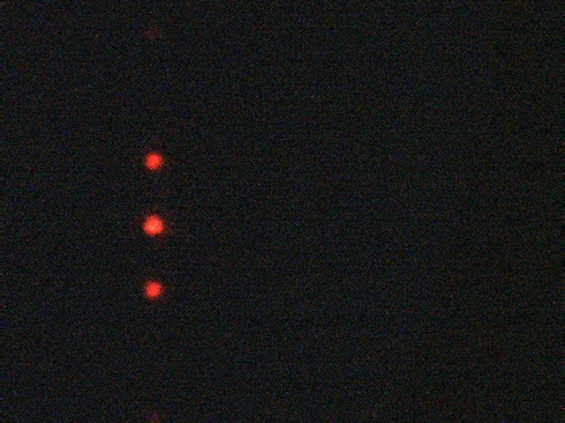



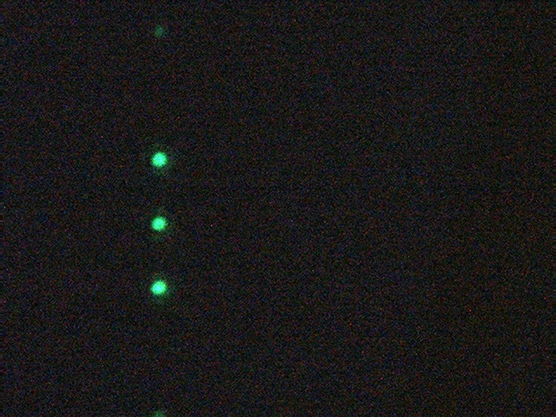


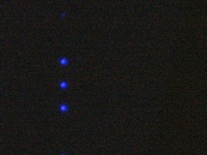




3. Simulation results of binary phase gratings
$w=$ $350px$
$p=$ $128px$
I_-1=0.159
I_0=0.289
I_1=0.159
1080px
×
P4 is at 50°
$p=$ $108px$
I_-1=0.289
I_0=0.287
I_1=0.289
×
P4 is at 50°
$p=$ $96px$
I_-1=0.237
I_0=0.287
I_1=0.237
×
Phase1=exp(i*0)
Phase2=exp(i*0.64*π)
P4 is at -80°

Slide 5


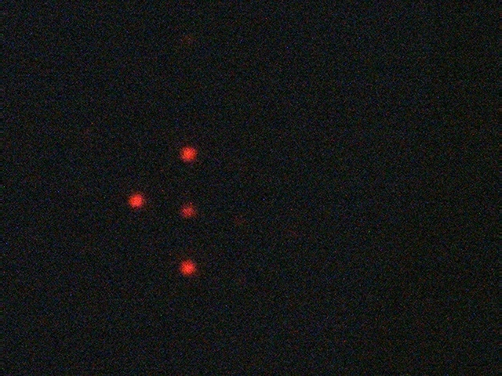




4. Simulation results of binary and blazed phase gratings
$p=$ $128px$
$w=$ $350px$
$p=$ $79px,1.85π$
$p=$ $400px,1.85π$
×
×
×
I_0= 7.05E-7 I_1= 0.513
I_-1=0.159
I_0=0.289
I_1=0.159
I_-1=0.1596
I_0=0.1397
I_1=0.2084
Triplicator, RGB= 92,0, 0.
The 0th is darker tan the other two orders.
But the 0th of blazed grating should not be that bright.

Slide 6




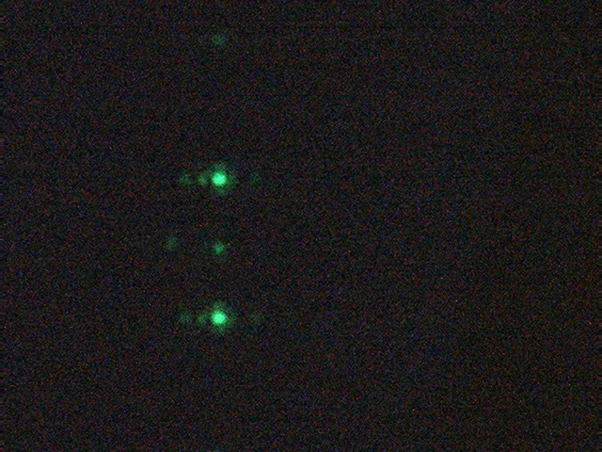



4. Simulation results of binary and blazed phase gratings
$p=$ $108px$
$w=$ $350px$
$p=$ $81px,2π$
$p=$ $640px,2π$
×
×
×
I_0= 5.7E-7 I_1= 0.533
I_-1=0.174
I_0=0.130
I_1=0.154
I_-1=0.289
I_0=0.287
I_1=0.289
Triplicator, RGB= 0,140, 0
The 0th is darker as same as calculated, but too much.

Slide 7





4. Simulation results of binary and blazed phase gratings_EXAMPLE
$p=$ $108px$
$w=$ $350px$
$p=$ $128px$
$p=$ $540px$
×
×
×
I_0=0
I_1= 0.9997
2pi
I_-1=0.273
I_0=0.271
I_1=0.273
I_-1=0.289
I_0=0.287
I_1=0.289

Slide 8


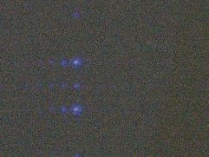


4. Simulation results of binary and blazed phase gratings
$p=$ $96px$
$w=$ $350px$
$p=$ $92px, 2π$
I_0=0
I_1= 0.945
×
×
Triplicator, RGB= 0,0, 112.
I_-1=0.224
I_0=0.271
I_1=0.224
I_-1=0.237
I_0=0.287
I_1=0.237
The 0th is darker.

Slide 9
5. Conclusión
The diffraction efficiency of triplicator and the intensity of each are affected by several factors:
Period of the binary phase grating. If the period is not the divisor of the height, at phase =0.64pi, we
might not have triplicator exactly.
Period of the blazed phase gratings. If the period is not the divisor of the height/width, the conversión
efficiency, from 0th to 1st, Will not be close to 1.
In experiment, the polarizer at reflection direction.

